Slide 1
Hill Cipher

Slide 2
Hill Cipher
Another interesting multiletter cipher is the Hill cipher.
The encryption algorithm takes m successive plaintext letters and substitutes for them m ciphertext letters.
The substitution is determined by m linear equations in which each character is assigned a numerical value (a = 0, b = 1 ... z = 25).

Slide 3

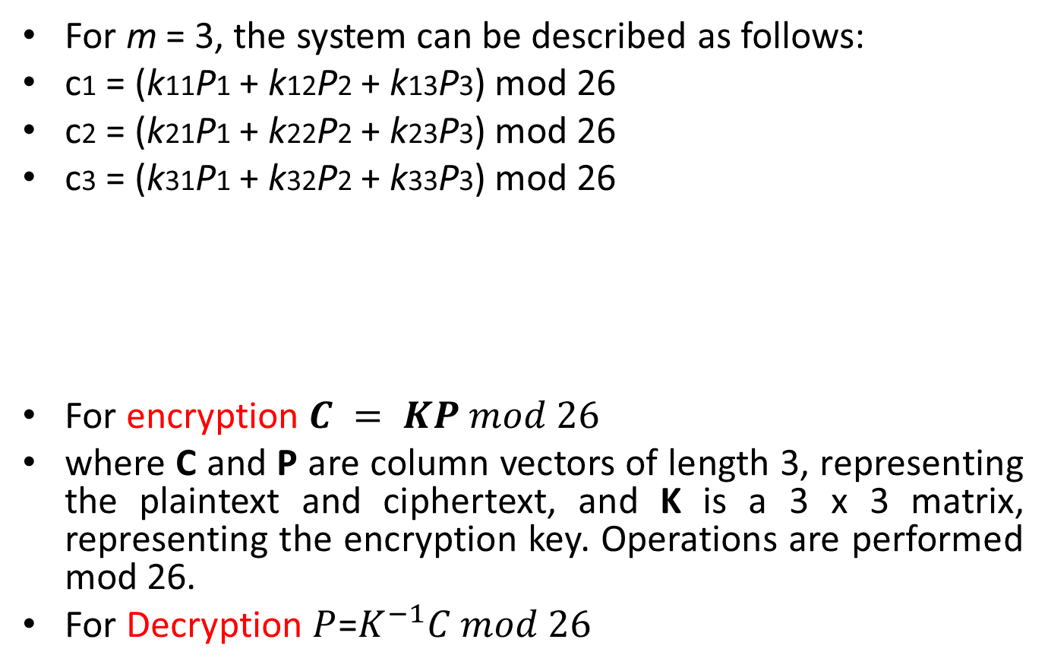
Hill Cipher
For m = 3, the system can be described as follows:
c1 = (k11P1 + k12P2 + k13P3) mod 26
c2 = (k21P1 + k22P2 + k23P3) mod 26
c3 = (k31P1 + k32P2 + k33P3) mod 26
For encryption $C = KP mod 26$
where C and P are column vectors of length 3, representing the plaintext and ciphertext, and K is a 3 x 3 matrix, representing the encryption key. Operations are performed mod 26.
For Decryption $P$=$K^{−1}C mod 26$

Slide 4

Hill Cipher: Example 1 Encryption
The plaintext message "short example"
The keyword hill and a 2 x 2 matrix.
The first step is to turn the keyword into a matrix.
If the keyword was longer than the 4 letters needed, we would only take the first 4 letters, and if it was shorter, we would fill it up with the alphabet in order

Slide 5

Hill Cipher: Example 1 Encryption
With the keyword in a matrix, we need to convert this into a key matrix. We do this by converting each letter into a number by its position in the alphabet (starting at 0). So, A = 0, B = 1, C= 2, D = 3, etc.

Slide 6


Hill Cipher: Example 1 Encryption
We now split the plaintext and write these as column vectors. That is, in the first column vector we write the first plaintext letter at the top, and the second letter at the bottom. Then we move to the next column vector, where the third plaintext letter goes at the top, and the fourth at the bottom. This continues for the whole plaintext.
Now we must convert the plaintext column vectors in the same way that we converted the keyword into the key matrix. Each letter is replaced by its appropriate number.

Slide 7


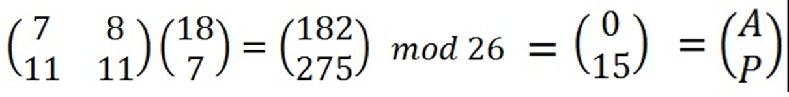
Hill Cipher: Example 1 Encryption
Now we must perform some matrix multiplication. We multiply the key matrix by each column vector in turn.

Slide 8
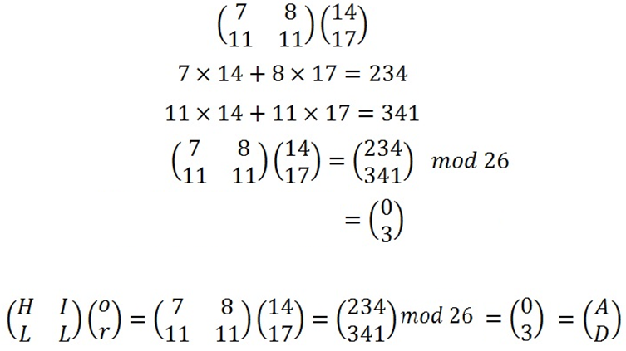
Hill Cipher: Example 1 Encryption

Slide 9
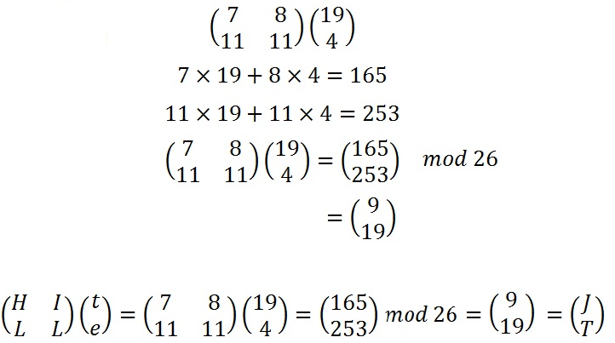
Hill Cipher: Example 1 Encryption

Slide 10
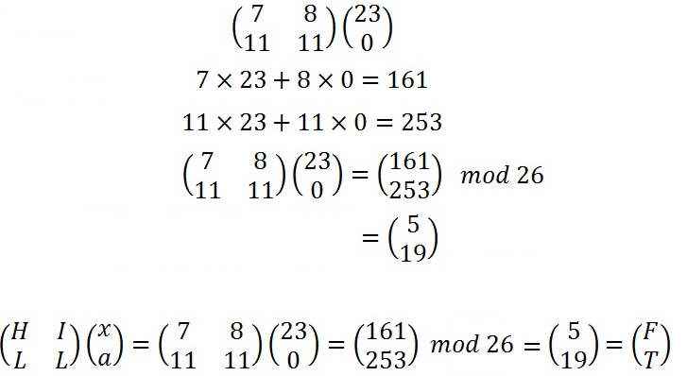
Hill Cipher: Example 1 Encryption

Slide 11
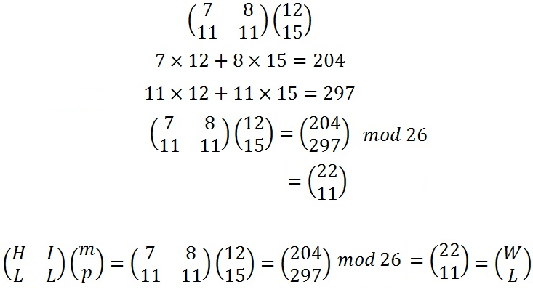
Hill Cipher: Example 1 Encryption
The final ciphertext is "APADJ TFTWLFJ".

Slide 12

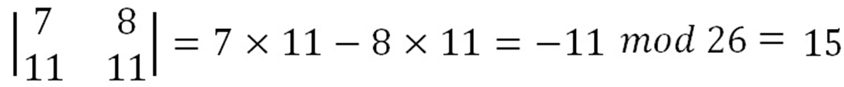
Hill Cipher: Example 1 Decryption
To decrypt a ciphertext encoded using the Hill Cipher, we must find the inverse matrix.
Where K is the key matrix, d is the determinant of the key matrix and adj(K) is the adjugate matrix of K.
Step 1: Find the Multiplicative Inverse of the Determinant

Slide 13


Hill Cipher: Example 1 Decryption
We now have to find the multiplicative inverse of the determinant working modulo 26. That is, the number between 1 and 25 that gives an answer of 1 when we multiply it by the determinant.
So the multiplicative inverse of the determinant modulo 26 is 7.

Slide 14


Hill Cipher: Example 1 Decryption
Step 2: Find the Adjugate Matrix
Again, once we have these values we will need to take each of them modulo 26 (in particular, we need to add 26 to the negative values to get a number between 0 and 25.

Slide 15
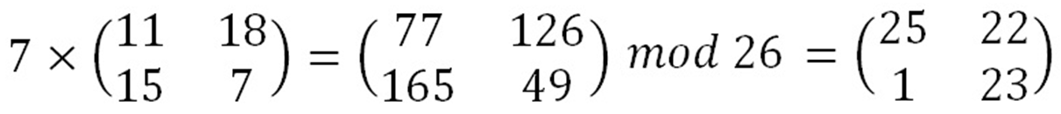

Hill Cipher: Example 1 Decryption
Step 3: Multiply the Multiplicative Inverse of the Determinant by the Adjugate Matrix
That is:

Slide 16
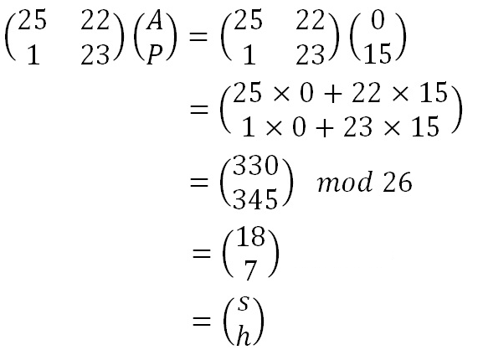
Hill Cipher: Example 1 Decryption
Now we have the inverse key matrix, we have to convert the ciphertext into column vectors and multiply the inverse matrix by each column vector in turn, take the results modulo 26 and convert these back into letters to get the plaintext.

Slide 17
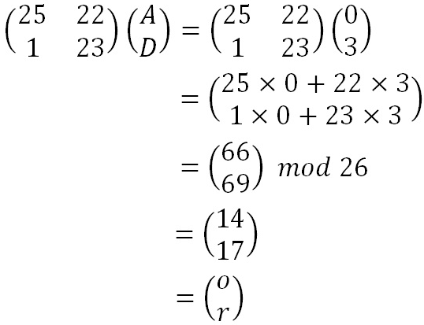
Hill Cipher: Example 1 Decryption

Slide 18

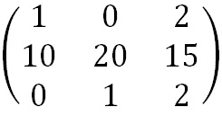
Hill Cipher: Example 2 Encryption
We shall encrypt the plaintext message "retreat now" using the key back up and a 3 x 3 matrix.
The first step is to turn the key into a matrix. Notice that the key is a few letters short, so we fill in the final elements with the start of the alphabet.

Slide 19
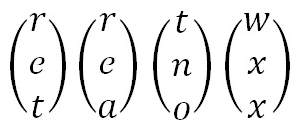
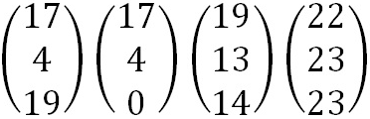
Hill Cipher: Example 2 Encryption
Now we split the plaintext into trigraphs (we are using a 3 x 3 matrix so we need groups of 3 letters), and convert these into column vectors.
However, since the plaintext does not go perfectly into the column vectors, we need to use some nulls to make the plaintext the right length. We then convert these into numeric column vectors.

Slide 20
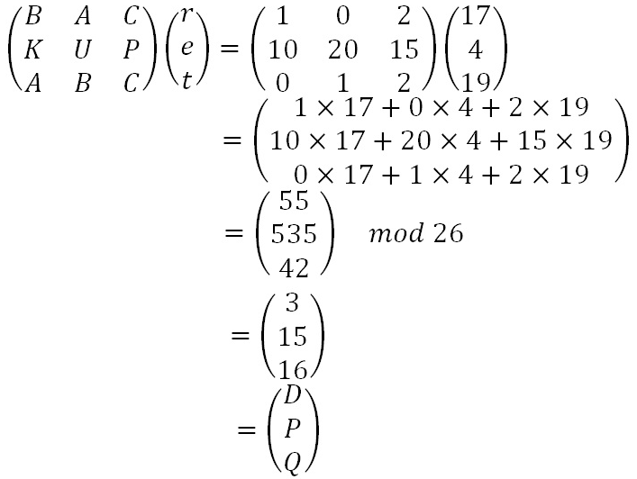
Hill Cipher: Example 2 Encryption
Now we perform matrix multiplication, multiplying the key matrix by each column vector in turn.

Slide 21
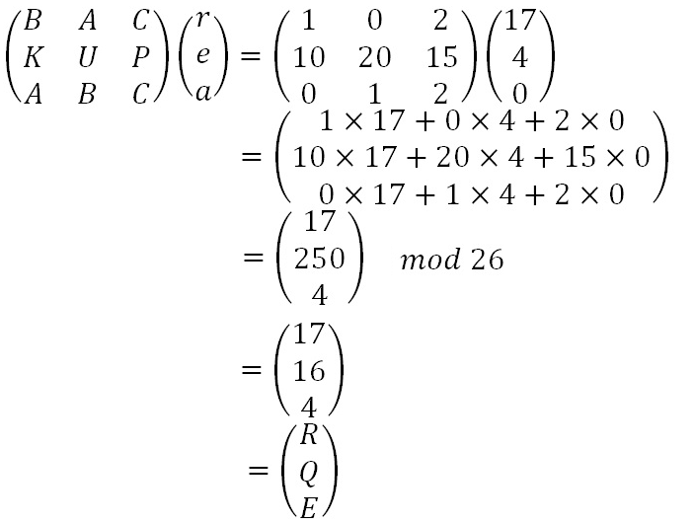
Hill Cipher: Example 2 Encryption

Slide 22
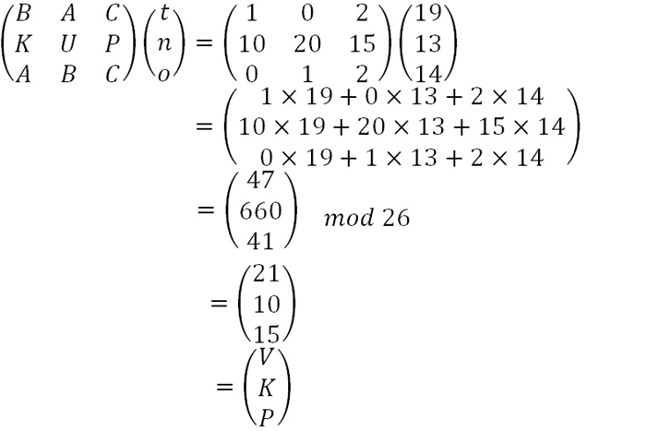
Hill Cipher: Example 2 Encryption

Slide 23
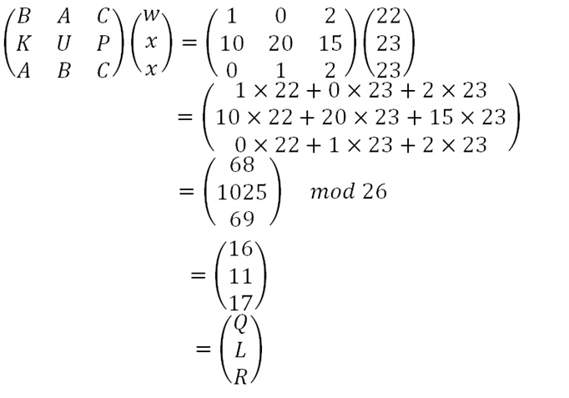
Hill Cipher: Example 2 Encryption
This gives us a final ciphertext of "DPQRQ EVKPQ LR".

Slide 24


Hill Cipher: Example 3 Decryption
We shall decrypt the ciphertext message "SYICHOLER" using the keyword alphabet.

Slide 25
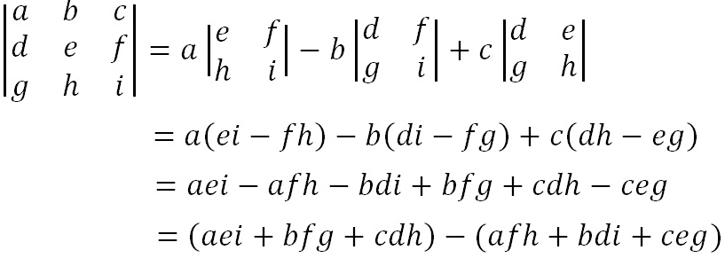
Hill Cipher: Example 3 Decryption
Step 1: Find the Multiplicative Inverse of the Determinant
The determinant is
Once we have calculated this value, we take it modulo 26.

Slide 26
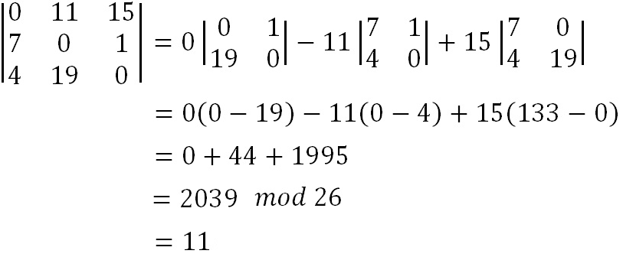
Hill Cipher: Example 3 Decryption

Slide 27


Hill Cipher: Example 3 Decryption
We now have to find the multiplicative inverse of the determinant working modulo 26. That is, the number between 1 and 25 that gives an answer of 1 when we multiply it by the determinant. So, in this case, we are looking for the number that we need to multiply 11 by to get an answer of 1 modulo 26.
So the multiplicative inverse of the determinant modulo 26 is 19.

Slide 28
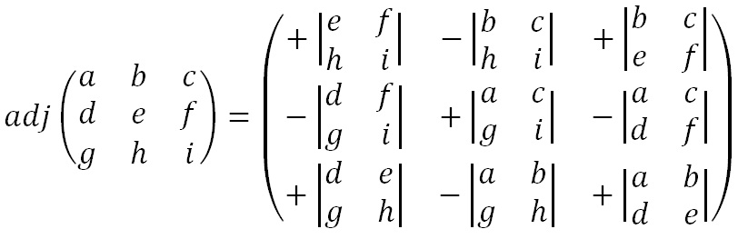
Hill Cipher: Example 3 Decryption
Step 2: Find the Adjugate Matrix

Slide 29
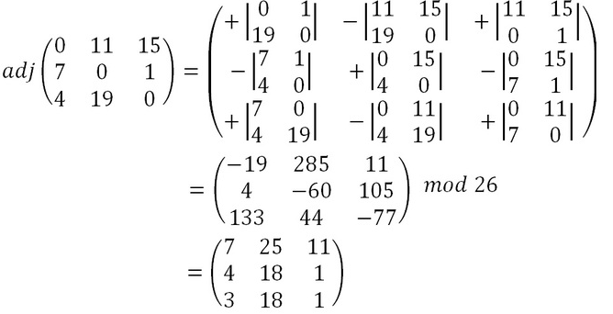
Hill Cipher: Example 3 Decryption

Slide 30
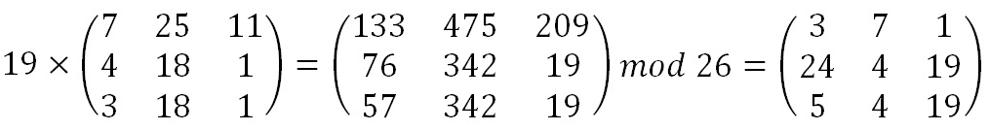
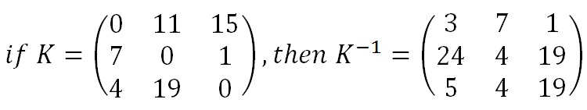
Hill Cipher: Example 3 Decryption
Step 3: Multiply the Multiplicative Inverse of the Determinant by the Adjugate Matrix

Slide 31
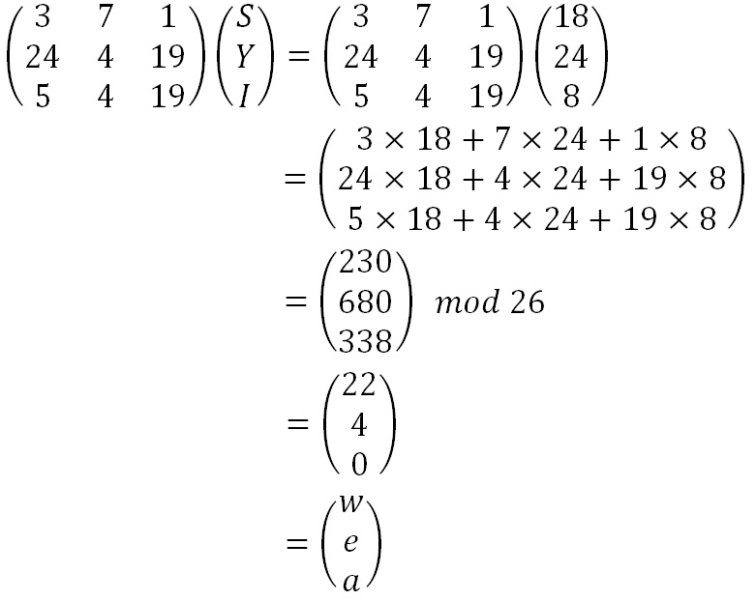
Hill Cipher: Example 3 Decryption
Finally, now we have the inverse key matrix, we multiply this by each

Slide 32
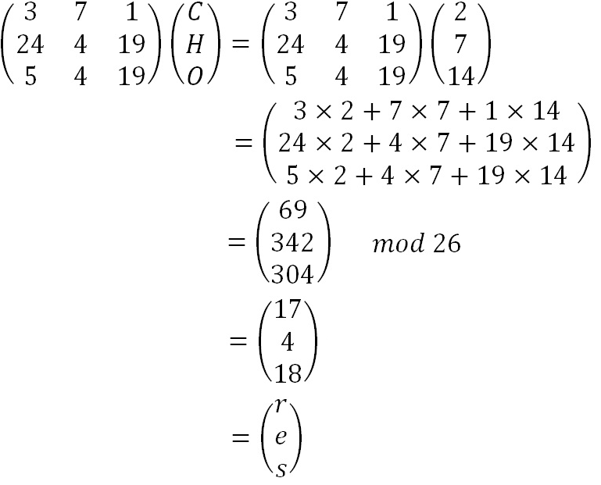
Hill Cipher: Example 3 Decryption

Slide 33
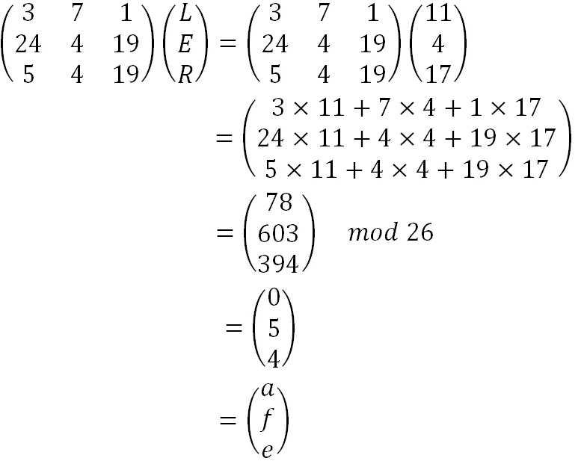
Hill Cipher: Example 3 Decryption
we retrieve our plaintext of "we are safe".

Slide 34

Hill Cipher: Example 4
Suppose that the plaintext "friday" is encrypted using a 2 x 2 Hill cipher to yield the ciphertext PQCFKU. Find the key?
Using the first two plaintext-ciphertext pairs, we have

Slide 35


Hill Cipher: Example 4
Notes:
d=9
d-1=3

Slide 36

PROBLEM
The plaintext "paymoremoney"
Encryption key
Find the ciphertext for the entire plaintext.
Decrypt the ciphertext.

